Slide 1
Component And Composite Approach to Aspect-Oriented Programming
Applications in Software Product Line Evolution

Slide 2
Software Component
Software component is unit of composition with explicitly determined (approval) and required interfaces and dependencies. Similarly, it can be independently deployed and is subject of composition performed by third parties. Component has no externally observable state.
Source: SZYPERSKI, Clemens, 2002. Component Software : Beyond
Object-Oriented Programming. ISBN 0-201-745572-0.
Unit of modularization exceeding the size of a single class that may be connected with other such units in different contexts.
Rather composed?

Slide 3
Composition Of Components
Aspects
SOA
Services are composed based on
on Loose coupling
Aspects are composed with
the rest of the code
Implementational level
Architectural level
Microservices
Micro-frontend
Using orchestrator like
Docker Swarm or Kubernetes
Architectural level

Slide 4
Composition Of
Components
Aspects
Aspects are composed with
the rest of the code
SOA
Implementational level
Services are composed based on
on Loose coupling
Architectural level
Microservices
Micro-frontend
… how can these respective components be used to effectively handle variability?
Using orchestrator like
Docker Swarm or Kubernetes
Architectural level

Slide 5
Independent Pointcuts On Specific Join Points
As are in Themes/UML approach
Use abstract pointcuts, and specify their behavior later for particular case
ABSTRACT ASPECTS
To reuse reuse components in different contexts
Managing internal structure on implementational level:
Exceeding exposed implantation of component … :
Propagating shared roles to particular entities
Preparing shared implementation without implementational details
Independent pointcuts on specific join points

Slide 6
State
Accompanied with the prescription of operations that can be taken
…when sequence of operations without any flag to rely upon is on the input
Where is the state in the code?
Where are states in the code?
Something like State machine diagrams
Stateful Pointcuts in JAsCo

Slide 7
State Dependent Behaviour
SOFTWARE BEHAVIOUR
Highly interactive and state dependent
STATE MACHINES
No explicit
support of their
abstractions in natural oop
states
behavior dependencies
on state
state transitions
PROBLEM TO DECOMPOSE THEIR DEFINITION
To Ensure Stability and Consistency
EXPLICIT STRUCTURE TO STATE MACHINES

Slide 8
JAsCo
Java Aspect Composition
Research project from Brussels Vrije available online: http://ssel.vub.ac.be/jasco/
Aspect oriented programming language tailored for component-based use
Run time weaver
Highly reusable aspects and composition mechanism
Capabilities:
  Stateful pointcuts – incorporation of state management
  Connectors – separation of the way how aspects are connected to specific join points [Adaptive Programming]
Unmaintained, academic project
Harder learning curve then in AspectJ

Slide 9
Links
Source from : http://ssel.vub.ac.be/jasco/lib/exe/fetch2cc0.pdf?cache=cache&media=taosd05.pdf
Download to run: http://ssel.vub.ac.be/jasco/kernel.html
Documentation: http://ssel.vub.ac.be/jasco/documentation_main.html

Slide 10
Connector in JAsCo
Hooks in JAsCo
class MyClass {
boolean turnedOn = false;
hook MyHook {
MyHook(amethod (..args)) {
execute(amethod);
}
isApplicable() { return global.turnedOn; }
around() { System.out.println(”around”); }
}
}
Is some kind of advice and like nested class
Method will be specified
Stored/expressed in classes as hooks
constructor
Pointcut is defined in constructor of the hook
Defining when hook is active:
method isApplicable()
Source: Aspekty v analýze a návrhu – Komponentový a kompozičný prístup k aspektovo-orientovanému programovaniu Poznámky k prednáškam z predmetu
Aspektovo-orientovaný vývoja softvéru, Valentino Vranić, 2017
Defining the connector with the hook
Connects aspects with code – without them aspects are not
modifying the original program
Applicable on
all methods
As a binding in Theme/UML
Example:
static connector MyConnector {
MyClass.MyHook hook0 = new p.MyClass.MyHook(∗ ∗.∗(..));
}

Slide 11
State
Accompanied with the prescription of operations that can be taken
…when sequence of operations without any flag to rely upon is on the input
Where is the state in the code?
Where are states in the code?
Something like State machine diagrams
Stateful Pointcuts in JAsCo

Slide 12
Stateful Code - Core
Used methods that
should be executed
Type of
transitions
public class MyLogger {
hook LogHook {
LogHook(startmethod(..a1), logmethod(..a2), stopm(..a3)) {
start>p1;
p1: execute(startmethod) > p3||p2;
p2: execute(logmethod) > p3||p2;
p3: execute(stopm) > p1;
}
before() {
System.out.println(thisJoinPoint.getName());
} \\ ak chceme len p2(): before p2() { . . . }
}
}
a) Explicit start transition
b) Two possible destination
transitions
c) Two start transitions:
start>p1 || p2;
d) No transition:
p2: execute(logmethod)
&& !cflow(stopm);

Slide 13
Connector for Stateful Code
Defining the connector with the hook
Connects aspects with code – without them aspects are not modifying the original program
As a binding in Theme/UML
static connector MyLoggerConnector {
MyLogger.LogHook hook0 = new MyLogger.LogHook(
void mypackage.Main.x(),
void mypackage.Main.y(),
void mypackage.Main.z()
);
}

Slide 14
Example Program With State
Defining the methods and custom program
public class Main {
public static void main(String[] args) {
Main m = new Main();
m.x();
m.x();
}
public void x() { y(); }
public void y() { z(); }
public void z() { zzz(); }
public void zzz() { System.out.println(”out”); }
}
Output:
x
y
z
out
x
y
z
out

Slide 15
Another Example
Method does not move from the initial state
public static void main(String[] args) {
Main m = new Main();
m.z();
m.z();
}
Output:
out
out

Slide 16
JAsCo and Adaptive Programming
Law of Demeter – method can communicate only with arguments, part objects (stored or computed) and newly created objects
class ViolatingDemetersLaw {
MyClass myClass;
public void do() {
myClass.getVariable1().doSomething(-1);
}
}
Resolved with:
class DemetersLaw1 {
MyClass2 myClass2;
public void do() {
myClass2.do (-1);
}
}
class MyClass2 {
MyClass3 myClass3;
public void do(int i) {
myClass3.doSomething(i);
}
}
Still, Do() logic pollutes code
– is scattered in several classes

Slide 17
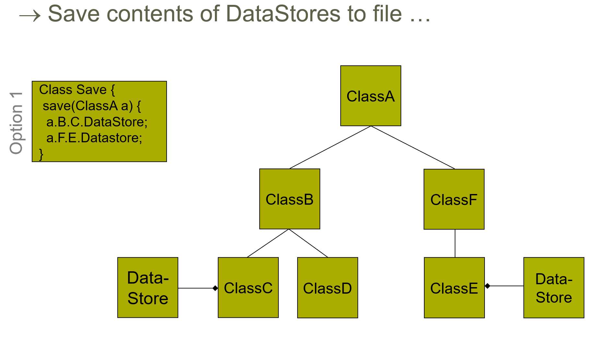
Source:
http://ssel.vub.ac.be/jasco/lib/exe/fetchb6e2.php?cache=cache&media=documentation%3Ajasco-vub-session1.ppt

Slide 18
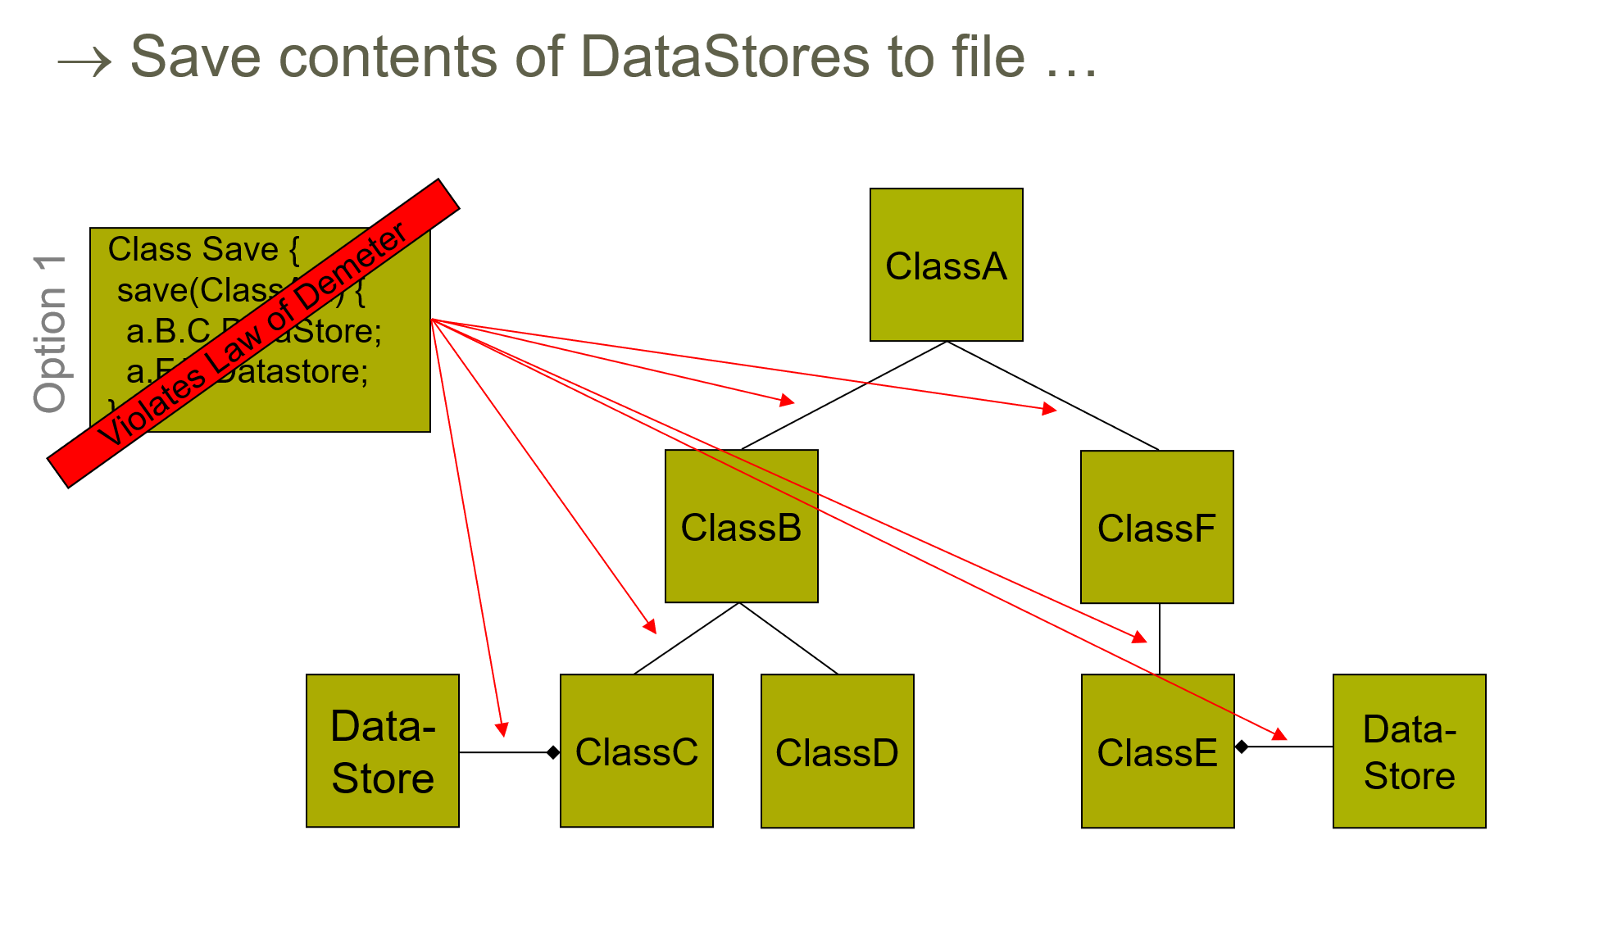
Source:
http://ssel.vub.ac.be/jasco/lib/exe/fetchb6e2.php?cache=cache&media=documentation%3Ajasco-vub-session1.ppt

Slide 19
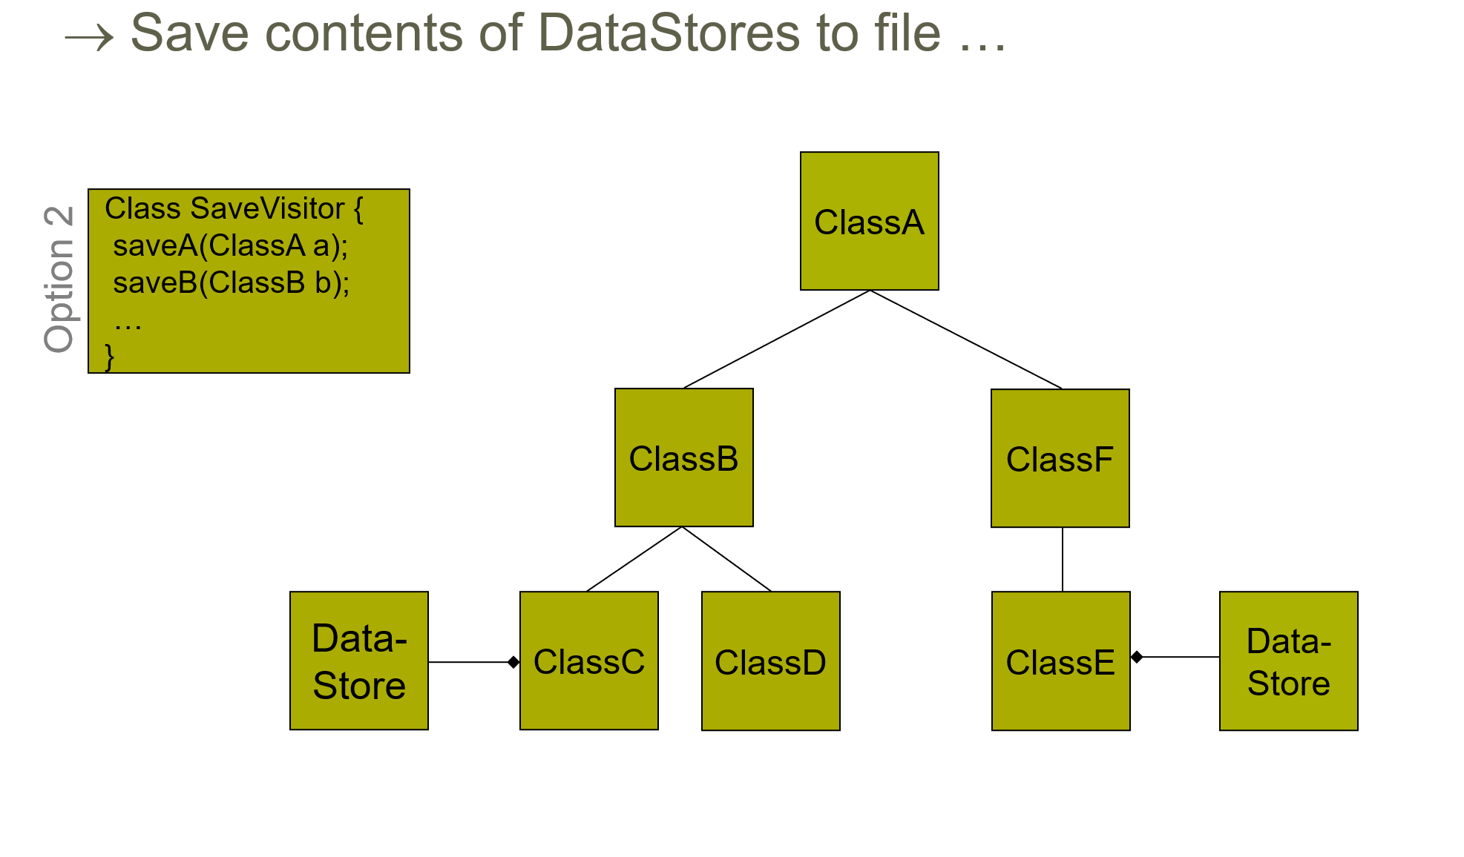
Source:
http://ssel.vub.ac.be/jasco/lib/exe/fetchb6e2.php?cache=cache&media=documentation%3Ajasco-vub-session1.ppt

Slide 20
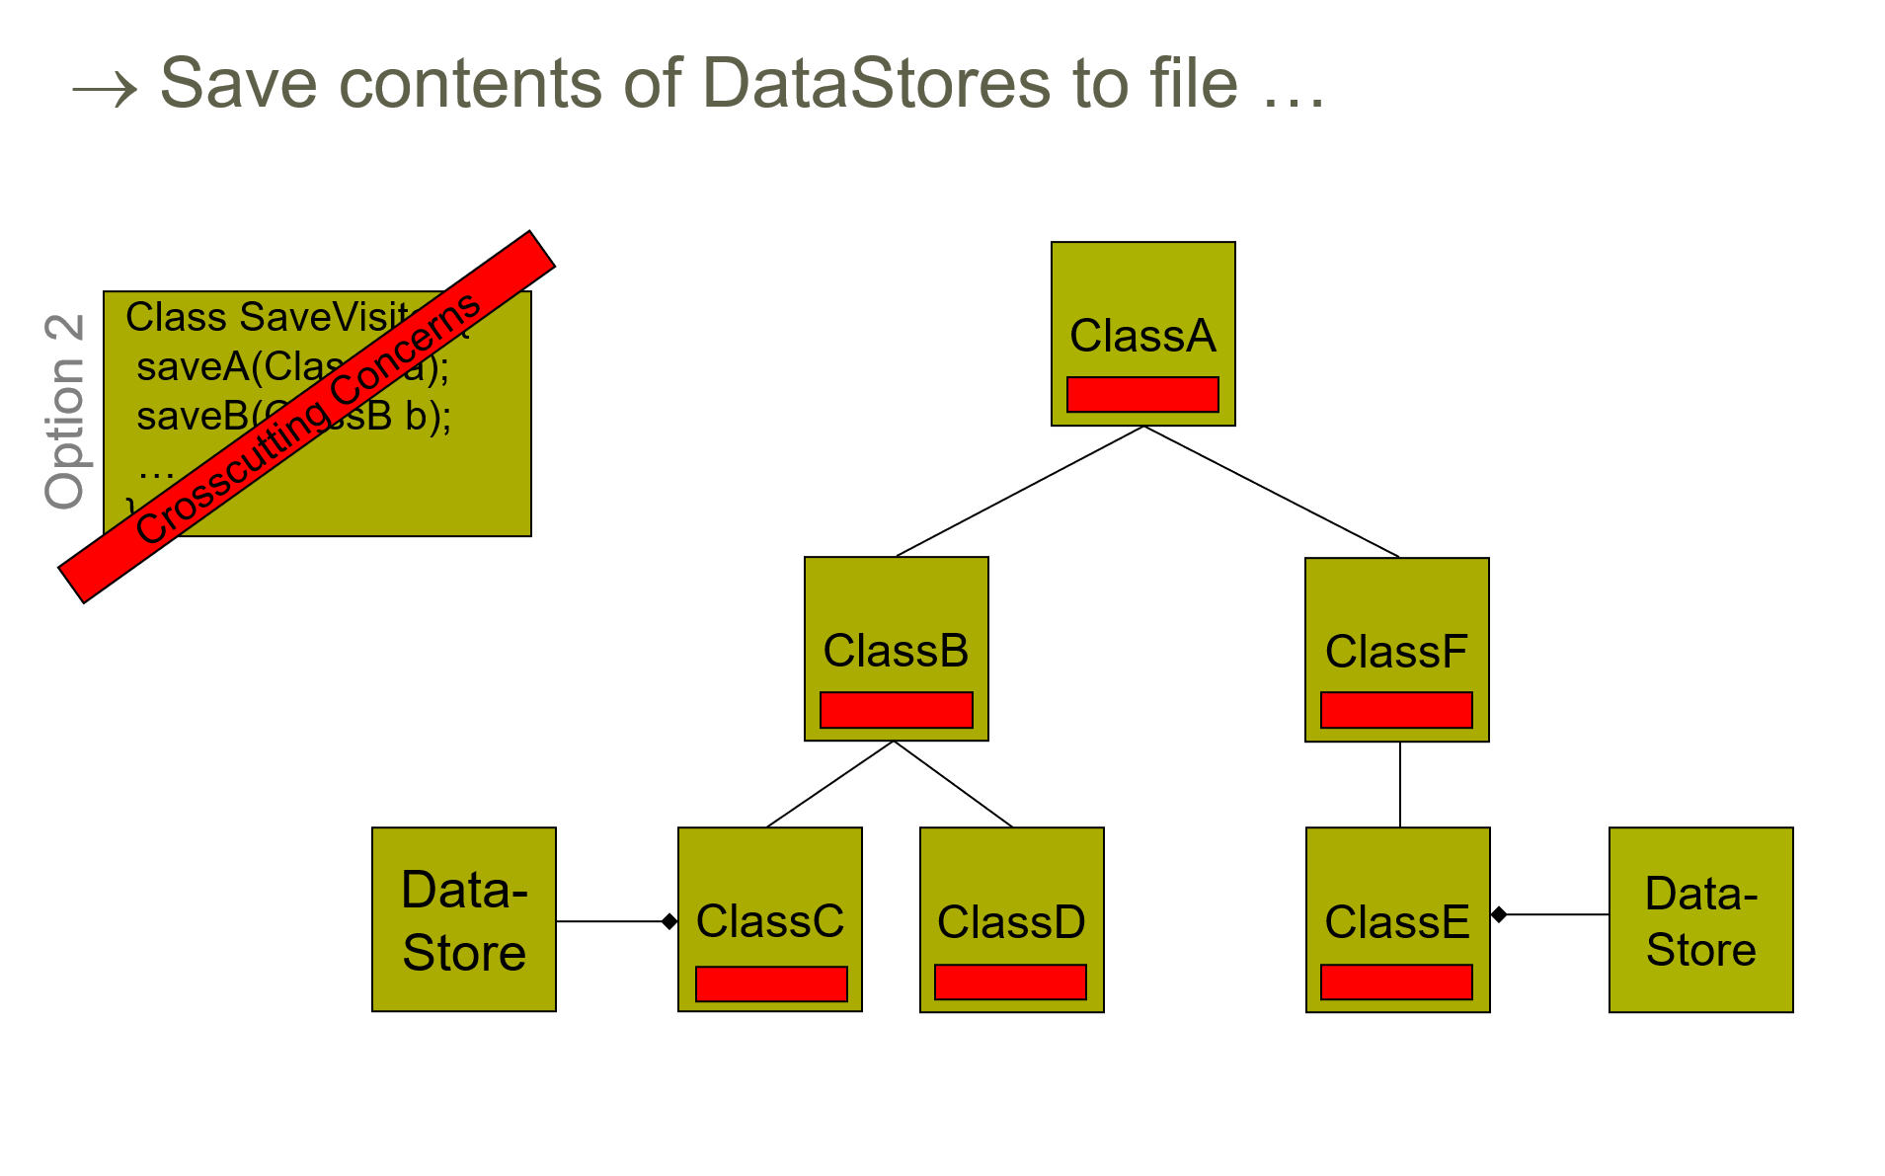
Source:
http://ssel.vub.ac.be/jasco/lib/exe/fetchb6e2.php?cache=cache&media=documentation%3Ajasco-vub-session1.ppt

Slide 21
Use of Adaptive Programming to Solve Following Dilemma
Dilemma:
  Crosscutting concerns (if follow) or
  Unmaintainable code (if not follow)
Source:
http://ssel.vub.ac.be/jasco/lib/exe/fetchb6e2.php?cache=cache&media=documentation%3Ajasco-vub-session1.ppt

Slide 22
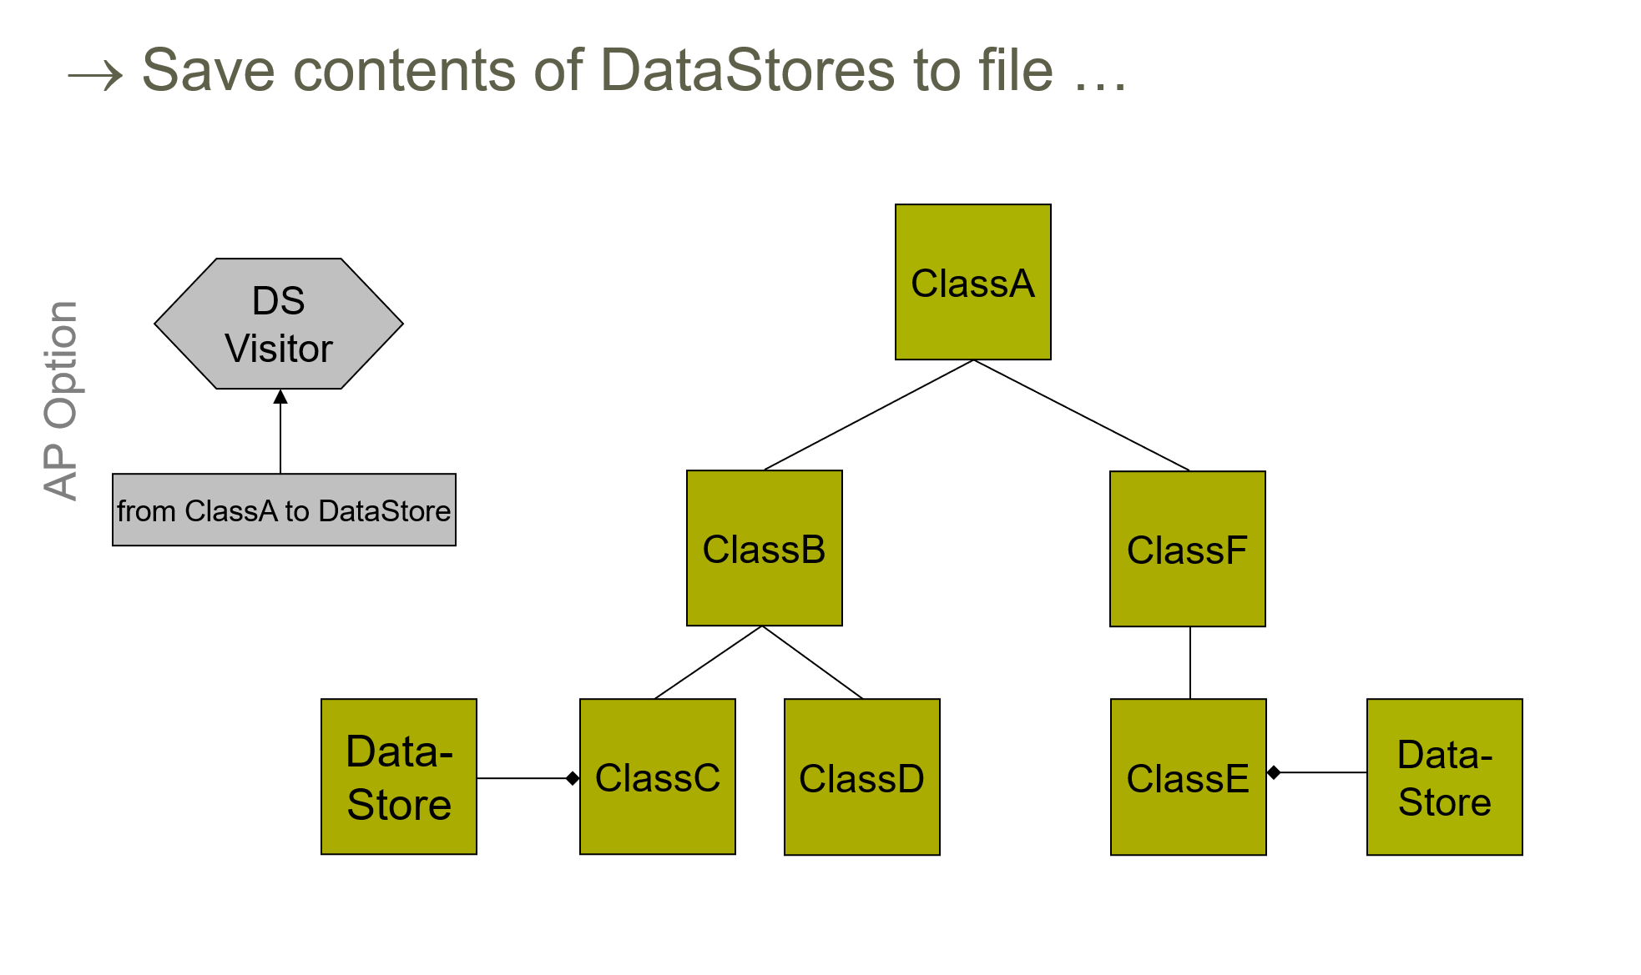
Source:
http://ssel.vub.ac.be/jasco/lib/exe/fetchb6e2.php?cache=cache&media=documentation%3Ajasco-vub-session1.ppt

Slide 23
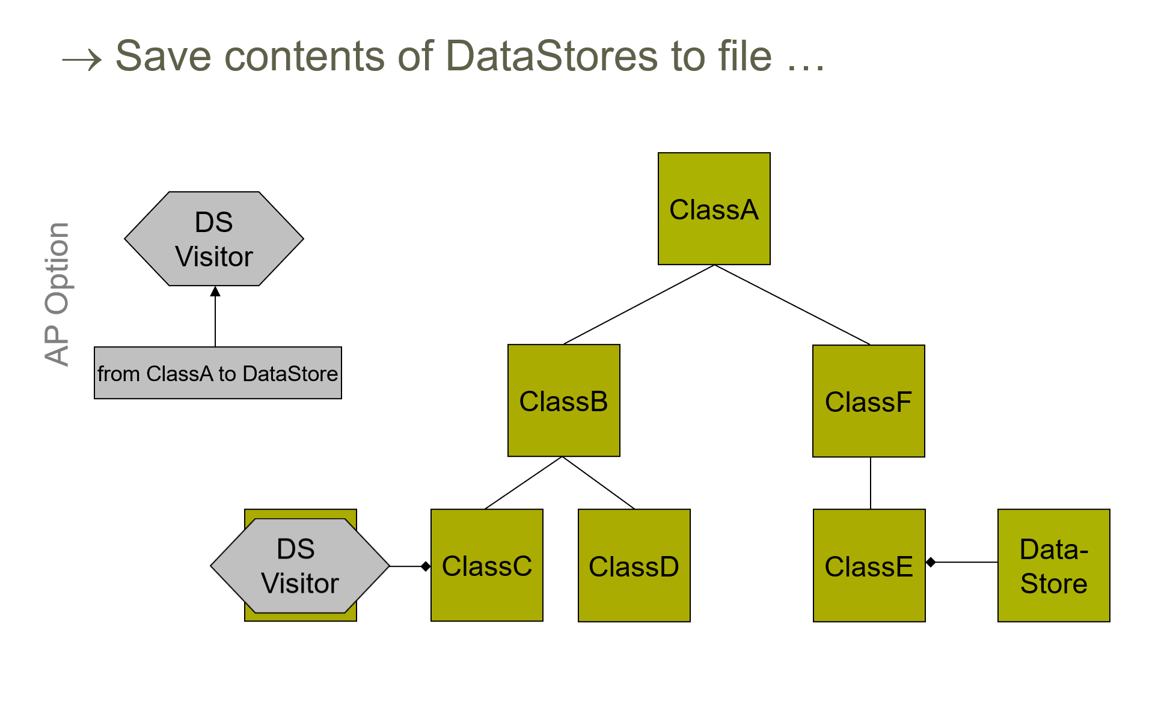

Slide 24
Implementation in JAsCo
Transversal strategy
Adaptive visitor
Traversal that is followed
-traverses the specified path
-contains implementation of behaviour
Example: from ClassA to DataStore

Slide 25
JAsCo Code for Adaptive Programming
class DataStorePersistence extends Visitor {
public void before(DataStore store) {
if(changedPV(store)) {
Writer writer = …
writer.writeObject(store.getData());
}
}
public boolean changedPV(DataStore s) {
\\ true if changed since last visit
}
}
void backup(ClassA a) {
ClassGraph cg = new ClassGraph(“a”);
Strategy sg = new Strategy(“from ClassA to DataStore”);
TraversalGraph tg = new TraversalGraph(sg, cg);
tg.traverse(a, new DataStorePersistence());
}

Slide 26
JAsCo Code for Adaptive Programming
class DataPersistence {
hook Backup {
Backup(triggeringmethod(..args)) {
execution(triggeringmethod); }
isApplicable() {
// true when changed since last visit }
before() {
Writer writer = …
writer.writeObject(getDataMethod());
}
refinable Object getDataMethod();
}
}
connector PersistenceConnector {
DataPersistence.Backup hook = new
DataPersistence.Backup(
* DataStore.set*(*));
}
refining DataPersistence.Backup
for DataStore {
public Object getDataMethod() {
DataStore d = thisJoinPointObject;
return d.getData();
}
}

Slide 27
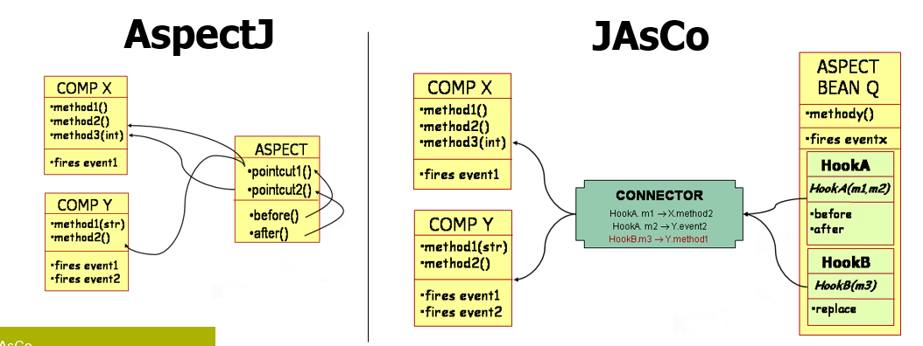
Comparison With AspectJ
Source: http://ssel.vub.ac.be/jasco/lib/exe/fetchb6e2.php?
cache=cache&media=documentation%3Ajasco-vub-session1.ppt

Slide 28
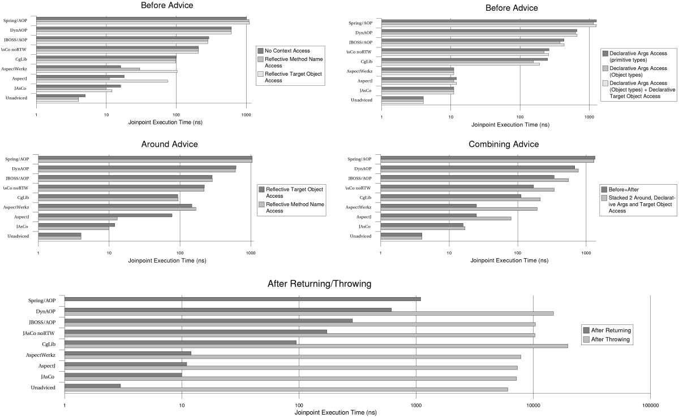
Source: http://ssel.vub.ac.be/jasco/lib/exe/fetche3d5.png?cache=cache&media=benchdrawing2.png

Slide 29
New Dimension in Software: Variability
Software product lines as complex software intensive systems
Increased complexity:
-evolution of common assets
-independent evolution of products and their instantiation
Independent on structure, behaviour, and its state
- problem with modularization
Modularizing different kinds of variability
Preserving encapsulation and communication over explicit interfaced

Slide 30
Feature-Oriented Decomposition
Analysis only of those modules of the features that are available in product
Design benefits
- Independent evolution of product line features
- Modular introduction of new features
- Does not always reflect on technical commonalities between features
Does not rely on one-to-one correspondence of
features from feature model and features describing
variations in software product line
and implementation modules
Taken from: Rashid, A., Royer, J.C., Rummler, A. (eds.):
Aspect-Oriented, Model-Driven Software Product Lines:
The AMPLE Way (09 2011)

Slide 31
Modularization And
Components Applied in Software Product Lines: Creation of houses with rooms and floors
In OOP world / In AOP world

Slide 32
ECaesarJ
Application to evolution of software product lines
Type-safe
Stable decomposition of majority of software abstractions:
  Classes
  Methods
  Events
  State
    Binding
    Mixin Composition

Slide 33
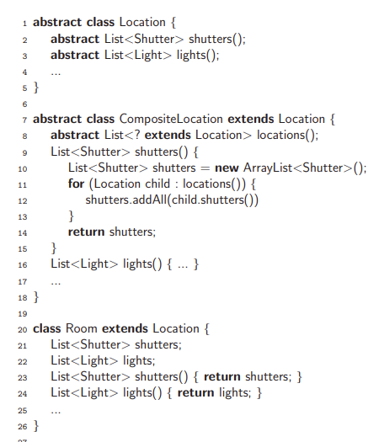
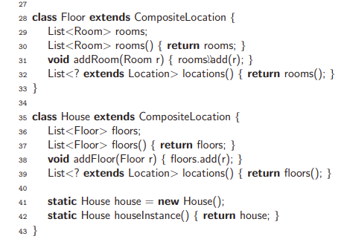
Object-Oriented
Solution
Taken from: Rashid, A., Royer, J.C., Rummler, A. (eds.): Aspect-Oriented,
Model-Driven Software Product Lines: The AMPLE Way (09 2011)

Slide 34
Class diagram

Slide 35
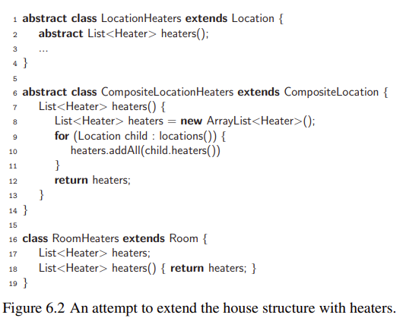
Attempt to extend original structure with heaters
to support heating features
Extended only individually:
Not replaced by their extensions
(extended code) in their relation
with other classes
Example: Not all type of rooms will have heaters after extension is applied
Taken from: Rashid, A., Royer, J.C., Rummler, A. (eds.): Aspect-Oriented,
Model-Driven Software Product Lines: The AMPLE Way (09 2011)

Slide 36
Extended class diagram

Slide 37
Modularization of Static Structures
1. No replacement of classes in inheritance relationship.
-redeclaration of inheritance relationship
between classes
MULTIPLE INHERITANCE
Impossible in Java
- introduction of additional glue code (for example in C++)
2. Incorporation of planned functionality (domain knowledge)
INVASIVE CHANGES OTHERWISE
If open-closed principle cannot be used = implementation of core features has to be changed
                during introduction of product-specific feature
3. Instantiation of extended classes instead of original ones
REDEFINITION IN ALL PLACES WHERE
EXTENDED CLASS IS INSTANTIATED
Here:

Slide 38
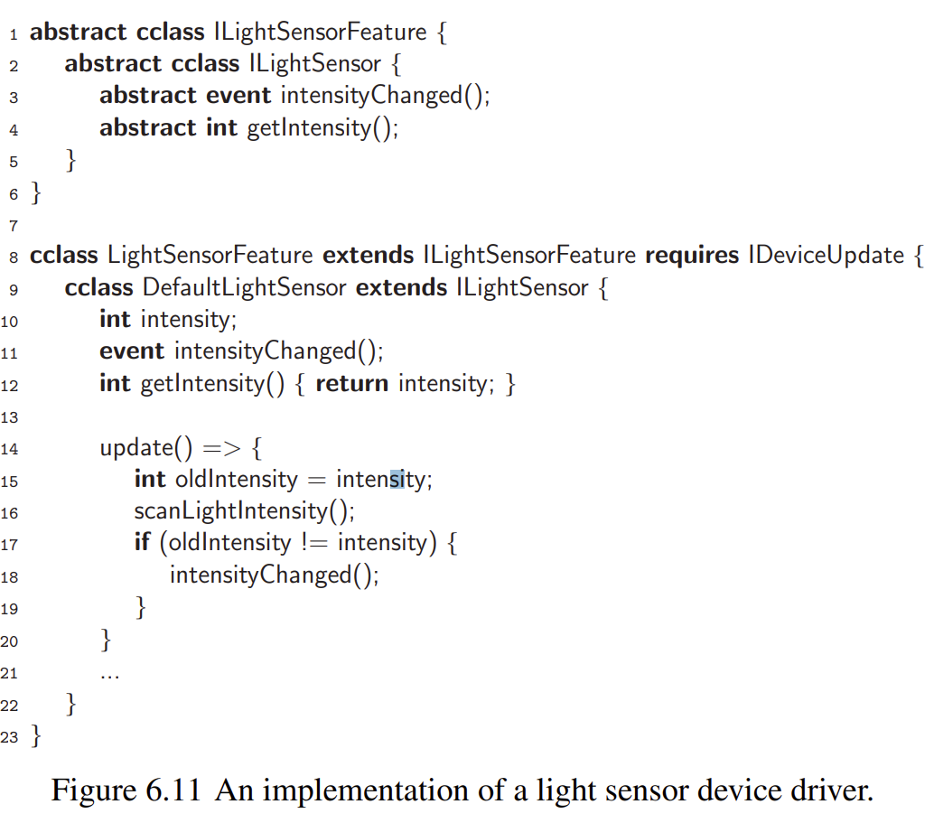
Implicit
Events
Definition of event as class member
-integrates the pointcuts of AspectJ
Not explicitly triggered
Definition of event as class members
-occur as result of other event
occurences
Define events in declarative way
As expressions over other events:
TYPES
-possibly to specialize based on
introduced conditions on parameters
exposed by events
Taken from: Rashid, A., Royer, J.C., Rummler, A. (eds.): Aspect-Oriented,
Model-Driven Software Product Lines: The AMPLE Way (09 2011)
-on values computed in the scope
of enclosing class
-as composition of other events
using logic operators

Slide 39
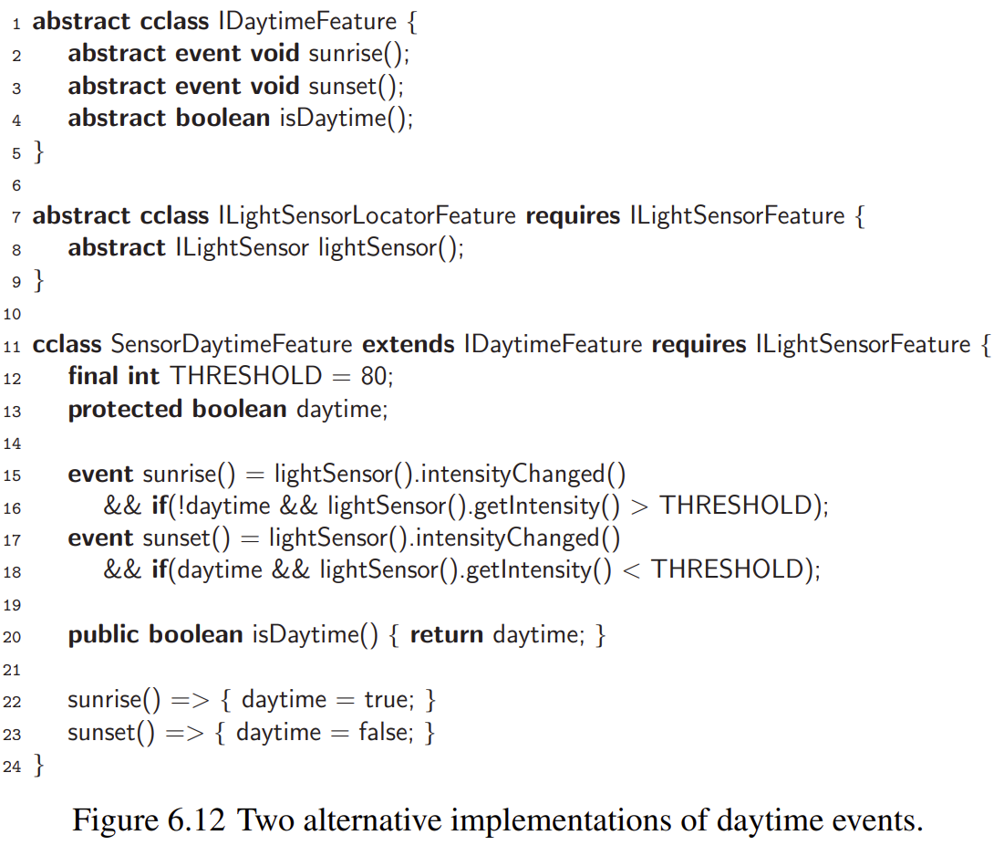
Implicit
Events
Taken from: Rashid, A., Royer, J.C., Rummler, A. (eds.): Aspect-Oriented,
Model-Driven Software Product Lines: The AMPLE Way (09 2011)
DECOUPLED EVENT
FROM ITS EVENT
DEFINITION
-[expr.]eventName(formalArgs) => body

Slide 40
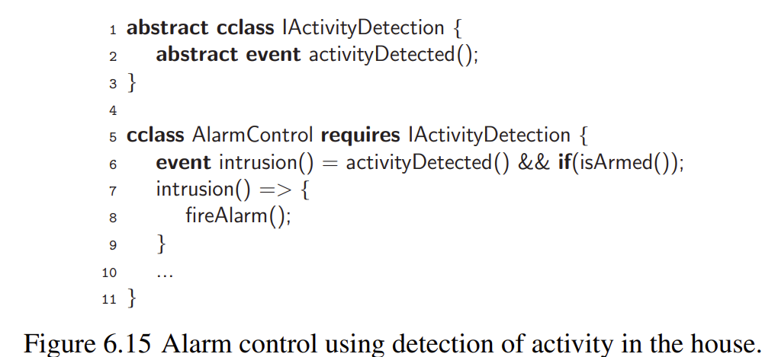
Taken from: Rashid, A., Royer, J.C., Rummler, A. (eds.): Aspect-Oriented,
Model-Driven Software Product Lines: The AMPLE Way (09 2011)

Slide 41
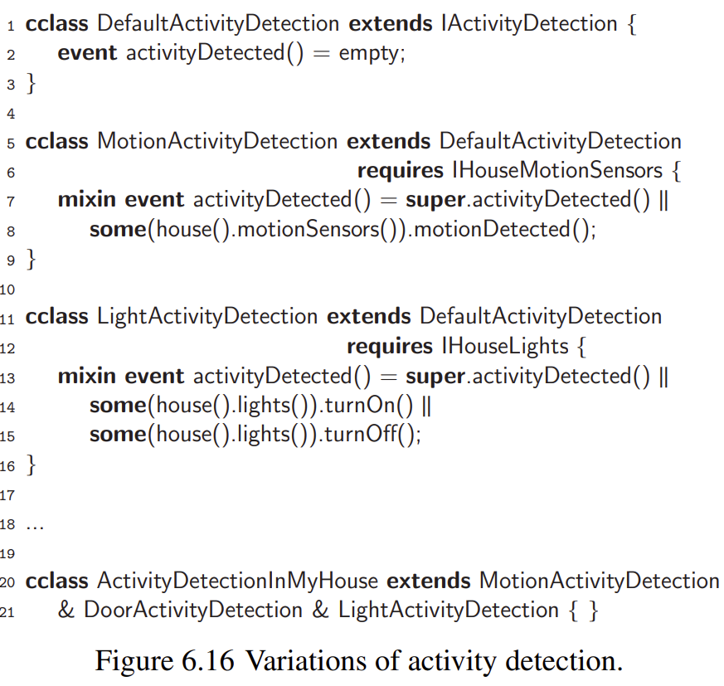
Mixin Composition Of Events
To mark conflicting situations
to resolve them automatically
– use of mixin keyword
Taken from: Rashid, A., Royer, J.C., Rummler, A. (eds.): Aspect-Oriented,
Model-Driven Software Product Lines: The AMPLE Way (09 2011)

Slide 42
Handling Event Using Observer Design Pattern
Modularization of behaviour
1. Much glue code – registration and notification of observers
2. Incorporation of planned functionality (domain knowledge)
INVASIVE CHANGES OTHERWISE
If open-closed principle cannot be used = implementation of core features has to be changed
                during introduction of product-specific feature
3. No support of declarative definition of events
Difficult to reuse for defining
other kind of events
EXPLICIT TRIGGERING IS NECESSARY

Slide 43
Use of ECaesarJ
Why?
Insufficient
mechanisms in OOP
for modularizing the
features
PROVIDES LARGE-SCALE SELECTION AND COMPOSITION MECHANISMS
Only for individual
objects/classes
VIRTUAL CLASSES
PROPAGATING THE
MIXIN COMPOSITION
-inner classes
-late-bound instantiation
Multiple affected
objects/classes
by Features
Composition propagates
into virtual classes
-can be refined in subclasses
of enclosing class
ALL INHERITED DECLARATIONS
OF VIRTUAL CLASSES
WITH THE SAME NAME ARE MERGED
AUTOMATICALLY
-as family members
– members of instances of
the enclosing class [family objects/classes]
Large-scale
extension
mechanism

Slide 44
Virtual Class in ECaesarJ/CaesarJ
FURTHERBINDING
REACHING:
Consistent extension of group of classes
-a refinement of virtual class
-implicit inheritance from refined class
Adding new functionality
Overriding existing functionality
Methods, fields,
and inheritance
relationships
defining
Features as extension of
other features
-references to virtual class are
bounded to its the most specific refinement
modeling
-in family class
Domain
objects
Feature
REFINEMENT OF VIRTUAL CLASSES
Extending functionality between features:
In family
class
In virtual
classes
in subclasses
-in inheritance of these virtual classes

Slide 45
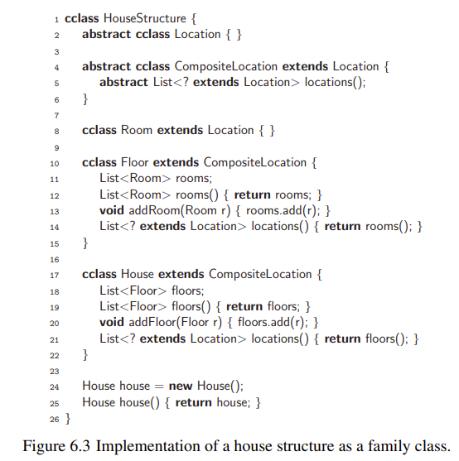
Implementation
in ECaesarJ
Feature
In family class
feature-oriented
modularization of
software product lines
To not confuse this with Java class
-to use it as extension ofJava
Domain
objects
cclass
In virtual
classes
New CaesarJ dat structure
Taken from: Rashid, A., Royer, J.C., Rummler, A. (eds.):
Aspect-Oriented, Model-Driven Software Product Lines:
The AMPLE Way (09 2011)

Slide 46
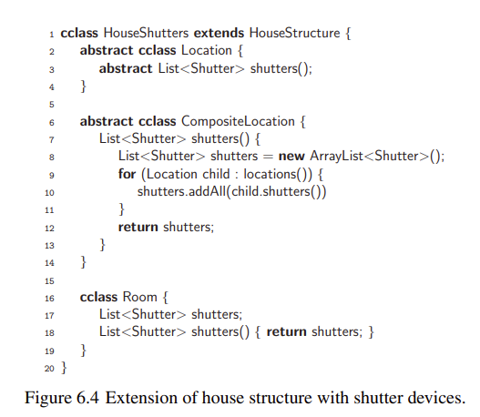
Furtherbinding
-extending features in consistent way
House structure is extended
with shutters
Access in
type-safe way
HouseShutters inherits all virtual
classes from HouseStructure and can
selectively extend them further
-references to virtual classes are always
relative to enclosing object
Automatically updated to refer to the new definitions
of these classes in family class
Taken from: Rashid, A., Royer, J.C., Rummler, A. (eds.):
Aspect-Oriented, Model-Driven Software Product Lines:
The AMPLE Way (09 2011)

Slide 47
Type-safety of type refinements
In consideration are only classes from the same
family objects = compatibility
- the types of nested virtual classes belong to
their parent this object

Slide 48
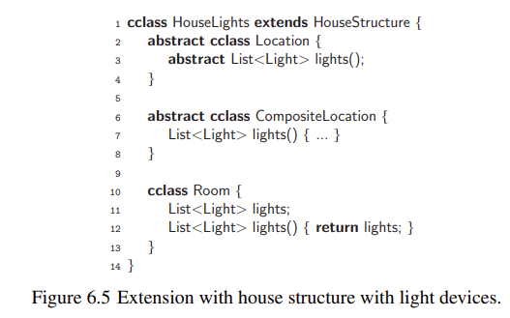
Mixins compositions
ORTHOGONAL EXTENSIONS
– contains not overlapping methods – with different name
-no conflicts during their composition
Taken from: Rashid, A., Royer, J.C., Rummler, A. (eds.):
Aspect-Oriented, Model-Driven Software Product Lines:
The AMPLE Way (09 2011)

Slide 49

Composing Features in CaesarJ/ECaesarJ
Propagating form of
mixin compositions
For automated resolution
methods should be explicitly
annotated with keyword mixin
Composition propagates
into virtual classes
ALL INHERITED DECLARATIONS
OF VIRTUAL CLASSES
WITH THE SAME NAME
RESOLVING THEIR PRECEDENCE
Conflicts are manually resolved
by developers
Linearisation order
of composed classes
All inherited members
Automatically merged: Virtual classes with the same name
For complete composition:
-each will contain all unique
methods amongst supertypes
Taken from: Rashid, A., Royer, J.C., Rummler, A. (eds.):
Aspect-Oriented, Model-Driven Software Product Lines: The AMPLE Way (09 2011)

Slide 50
Composition of Virtual Classes
COMPOSITION STEP 1:
cclass Composition extends
Layer3 & Layer2 & Layer1 { }
cclass Composition extends
Layer3 & Layer2 & Layer1 { }
(Layer2 & Layer1)
overwrites
Realization from right to left
COMPOSITION STEP 2:
<higher> → <lower> Priority
cclass Composition extends
Layer3 & Layer2 & Layer1 { }
cclass Composition extends
[Layer3 & (Layer2 & Layer1)] { }
overwrites

Slide 51
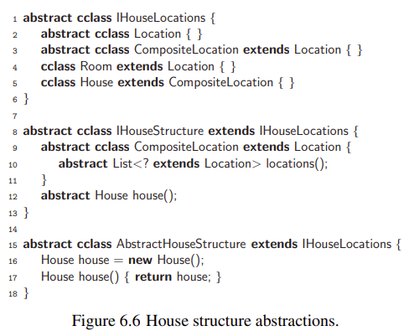
Decoupling features further: Abstract family classes
CANNOT BE INSTANTIATED!!!
Describes common abstractions
of multiple features
and interfaces between them
THREE LEVELS OF ABSTRACTIONS over House entity:
CAN BE USED AS INTERFACES
DESCRIBES ABSTRACTIONS OF OBJECT
FAMILIES NOT ONLY OF INDIVIDUAL OBJECTS
Possibly contains:
Abstract methods
Incomplete implemented virtual classes
BENEFITS IN INCORPORATION OF ABSTRACTIONS:
-to hide implementation details of features
-to abstract from alternative variations
On example: Hiding variations of House structure

Slide 52
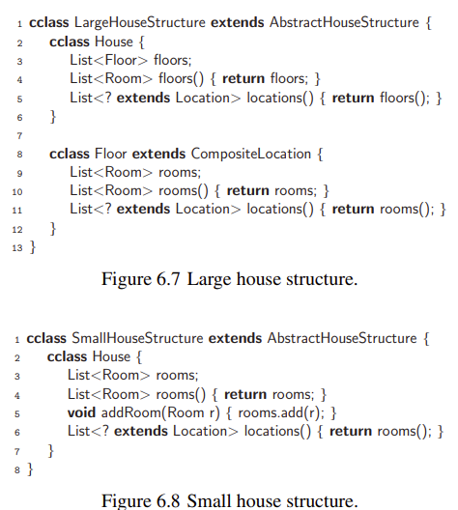
Extending abstract family classes
LARGE HOUSES
Covers following
variations
SMALL HOUSES
Taken from: Rashid, A., Royer, J.C., Rummler, A. (eds.):
Aspect-Oriented, Model-Driven Software Product Lines:
The AMPLE Way (09 2011)

Slide 53
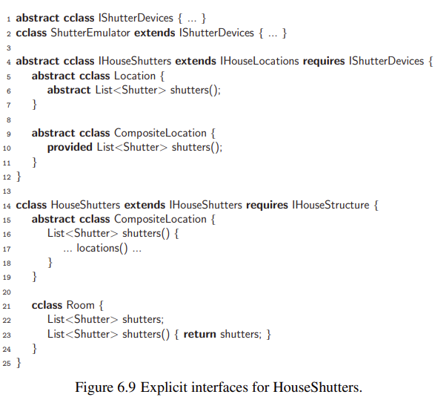
Interfaces in
ECaesarJ
Redesign to explicit interfaces:
Keyword required:
To implement the interface
Taken from: Rashid, A., Royer, J.C., Rummler, A. (eds.):
Aspect-Oriented, Model-Driven Software Product Lines:
The AMPLE Way (09 2011)

Slide 54
Taken from: Rashid, A., Royer, J.C., Rummler, A. (eds.):
Aspect-Oriented, Model-Driven Software Product Lines:
The AMPLE Way (09 2011)

Slide 55
CaesarJ
Aspect oriented programming language based on Java
Developed in Darmstadt and available in http://www.caesarj.org/

Slide 56
Composition Mechanism in CaesarJ
Pointcuts and Advices
Binding
Composition of Virtual Classes
-such as intertype declaration
in AspectJ
-in Caesar classes
-such as inheritance of virtual classes
-between two classes
-composed using & operator
public cclass AnAspect {
public pointcut APointcut(): .... ; public around() : APointcut() {
// code to insert
}
}
-one is wrapper and second one is wrappee
cclass Composition extends
Layer3 & Layer2 & Layer1 { }
-keyword wraps
Realization from right to left
<higher> → <lower> Priority

Slide 57
Representing Grafs using CaesarJ
public cclass WeightedGraph extends Graph {
public cclass Edge {
float cost;
}
public cclass Node {
float cost;
}
}
public cclass Graph {
public cclass Edge { Node start, end; }
public cclass UEdge extends Edge {...}
public cclass Node {...}
}
Source: http://www2.fiit.stuba.sk/~vranic/aosd/poznamky/komp.pdf

Slide 58
Preparing for Electrical Model Scheme Specialization
public class Wire {
public Pin getStartPin() { ... }
public Pin getEndPin() { ... }
...
}
public class Component {
public int getPinCount() { ... }
public Pin getPinByNr(int nr) { ... }
...
}
public class Pin {
public Component getOwner() { ... }
public Iterator getAttachedWires() { ... } ...
}
Source: http://www2.fiit.stuba.sk/~vranic/aosd/poznamky/komp.pdf

Slide 59
Graph Representation Using Caesar Classes
public cclass Graph {
. . .
public cclass Edge {
public Node getStartNode() { ... }
public Node getEndNode() { ... }
}
public cclass Node {
public Iterator getEdges() { ... }
}
}
Source: http://www2.fiit.stuba.sk/~vranic/aosd/poznamky/komp.pdf

Slide 60
Binding Creation
cclass ElectricGraph extends Graph {
cclass Edge wraps Wire { ... }
cclass Node wraps Component { ... }
}
cclass ElectricGraph extends Graph {
cclass Edge wraps Wire {
public Node getStartNode() {
return Node(wrappee.getStartPin().getOwner());
}
...
}
...
}
WRAPPER
WRAPPEE
WRAPPING/BINDING
Returnins the wrapper of Pin (Node)
ACCESSING THE INSTANCE OF THE WRAPPEE CLASS (WIRE)
Source: http://www2.fiit.stuba.sk/~vranic/aosd/poznamky/komp.pdf

Slide 61
Creating Instances of Wrapped Classes
Expression returning CeasarJ class object where is wrapper defined (this
in this case)
Reference to subtype of wrapper class
(wrappee.getStartPin()
.getOwner())
wrapper class
(Node)
-
this.Node(wrappee.getStartPin().getOwner())
Node(wrappee.getStartPin().getOwner())

Slide 62
Composition of Virtual Classes
COMPOSITION STEP 1:
cclass Composition extends
Layer3 & Layer2 & Layer1 { }
cclass Composition extends
Layer3 & Layer2 & Layer1 { }
(Layer2 & Layer1)
overwrites
Realization from right to left
COMPOSITION STEP 2:
<higher> → <lower> Priority
cclass Composition extends
Layer3 & Layer2 & Layer1 { }
cclass Composition extends
[Layer3 & (Layer2 & Layer1)] { }
overwrites

Slide 63
Cuckoo’s Egg
In CaesarJ
public cclass UncompromisedNest extends GeneralEgg {
public cclass Egg {
public void exec() {
System.out.println(”a real egg.”);
}
}
public cclass Nest {
public Nest() { }
public void exec() {
System.out.print(”The nest contains ”);
new Egg().exec();
}
}
public void app() {
new Nest().exec();
}
}
Symmetrically
using Composition
Overiden method
during composition
EMPTY
IMPLEMENTATION OF
GENERAL CAESAR CLASS:
Overiden method
during composition
public cclass GeneralEgg {
public cclass Egg { }
}
Source: http://www2.fiit.stuba.sk/~vranic/aosd/poznamky/komp.pdf

Slide 64
Composition Mechanism:
public cclass CuckoosNest
extends CuckoosEgg & UncompromisedNest { }
Cuckoo’s Egg:
public cclass CuckoosEgg extends GeneralEgg {
public cclass Egg {
public void exec() {
System.out.println(”a cuckoo’s egg.”);
}
};
}
Overwrites UncompromisedNest during composition
PRECEDENCE TO THIS METHOD during overiding
Eggs instantiation:
public class Main {
public static void main(String[] s) {
new UncompromisedNest().app();
new CuckoosNest().app();
}
}
The nest contains a real egg.
The nest contains a cuckoo’s egg.
Source: http://www2.fiit.stuba.sk/~vranic/aosd/poznamky/komp.pdf

Slide 65
Abstract
Observer
Pattern
in CaesarJ
Source: http://www2.fiit.stuba.sk/~vranic/aosd/poznamky/komp.pdf
abstract public cclass ObserverProtocol {
abstract public cclass Subject {
abstract public void addObserver(Observer o);
abstract public void removeObserver(Observer o);
abstract public void changed();
abstract public String getState();
}
abstract public cclass Observer {
abstract public void notify(Subject s);
}
}
Declaring Subject and Observer roles
-with all their supported methods

Slide 66
Observer in CaesarJ
public cclass ObserverProtocolImpl extends ObserverProtocol {
abstract public cclass Subject {
private List observers = new LinkedList();
public void addObserver(Observer o) {
observers.add(o);
}
public void removeObserver(Observer o) {
observers.remove(o);
}
public void changed() {
Iterator it = observers.iterator();
while (it.hasNext()) { ((Observer) it.next()).notify(this); }
}
}
}
Adding observer
List of
observers
Implementing abstract
subject role
Removing
observer
Notifying
observers when
state changes

Slide 67
Specializing
Observer
in CaesarJ
abstract public cclass ColorObserver extends ObserverProtocol {
public cclass PointSubject extends Subject wraps Point {
public String getState() {
return ”Point colored ” + wrappee.getColor();
}
}
public cclass LineSubject extends Subject wraps Line {
public String getState() {
return ”Line colored ” + wrappee.getColor();
}
}
public cclass ScreenObserver extends Observer wraps Screen {
public void notify(Subject s) {
wrappee.display(”Color changed: ” + s.getState());
}
}
Binding Subject Role with its
Implementation
on Line and Point
Binding Observer
Role with its
Implementation
on Screen
Source: http://www2.fiit.stuba.sk/~vranic/aosd/poznamky/komp.pdf

Slide 68
after(Point p): (call(void Point.setColor(Color)) && target(p)) {
PointSubject(p).changed();
}
after(Line l): (call(void Line.setColor(Color)) && target(l)) {
LineSubject(l).changed();
}
}
Implementing change
when color is set
Defining observed
event + its processing
Instantiation:
public cclass Test {
private deployed static final CO co = new ColorObserverImpl();
public void test() {
Line l = new Line();
Point p = new Point();
Screen s1 = new Screen();
Screen s2 = new Screen();
co.LineSubject(l).addObserver(co.ScreenObserver(s1));
co.PointSubject(p).addObserver(co.ScreenObserver(s1));
co.LineSubject(l).addObserver(co.ScreenObserver(s2));
l.setColor(new Color(”red”));
p.setColor(new Color(”blue”));
}
}
Composition:
public cclass ColorObserverImpl extends
ObserverProtocolImpl & ColorObserver { }
Abstract pattern implementation
Specific implementation/application
Source: http://www2.fiit.stuba.sk/~vranic/aosd/poznamky/komp.pdf

Slide 69
References
Product Line Implementation with ECaesarJ: Rashid, A., Royer, J.C., Rummler, A. (eds.): Aspect-Oriented, Model-Driven Software Product Lines: The AMPLE Way (09 2011)
Description and application of JaSCo: http://ssel.vub.ac.be/jasco/
Description and application of CaesarJ: https://caesarj.org/
Capabilities, Basics, Advanced topics and Application of AspectJ: The AspectJ in Action Laddad, Ramnivas, 2003. AspectJ in action: practical aspect-oriented programming. Greenwich, CT: Manning. ISBN 978-1-930110-93-9.
Component and composite approach notes: http://www2.fiit.stuba.sk/~vranic/aosd/poznamky/komp.pdf

